Slide 1
Angular Component Communication
Communicating with a Parent Component
Lecture 4
By James(Jin) Wang
12/27/2021

Slide 2
Outline
Child to Parent Component
Output Properties

Slide 3
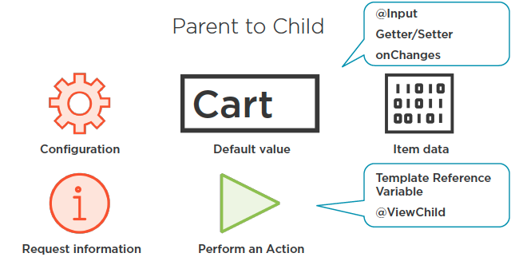
Child to Parent
  Parent to Child

Slide 4
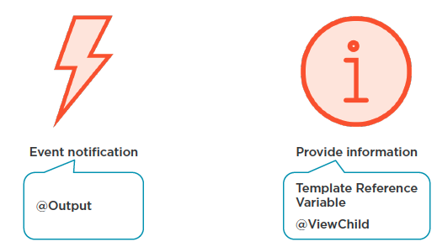
Child to Parent
  Child to Parent
  Demo: build a Child Component

Slide 5
Summary

Slide 6
Assignment

Slide 7
Self Study
  Angular Component Communication
  https://app.pluralsight.com/library/courses/angular-component-communication

